Slide 1






IMDB Movies Analysis
Presentation 2024
Presented By: Manu Moolimani

Slide 2



Description
The Purpose of this project is to analyze the IMDB dataset to determine the factors that influence the success of the movies. This analysis includes examining the various factors such as genre, duration, language, director, and budget on the IMDB scores. These insights help directors, producers, and investors make informed decisions.

Slide 3






Approach
Movie Genre Analysis
Determine the most common genres and calculating descriptive statistics for IMDB scores for those genre.
Movie Duration Analysis
Analyzing the distribution of movie durations and their impact on IMDB scores.
Language Analysis
Examining the distribution of movies by language and their impact on IMDB scores.
Director Analysis
Identifying top directors based on the average IMDB scores.
Budget Analysis
Exploring the relationship between movie budgets and profit earned.

Slide 4

Tech Stack
Microsoft Excel: Used for data cleaning, analysis, and visualization. Excel functions and tolls such as ‘COUNTIF’, ‘AVERAGEIF’, ‘MEDIAN and charting tools were utilized for the various tasks.

Slide 5
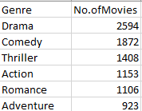
Movie Genre Analysis
The most Common genres were found to be Drama, Comedy, Thriller and others.
Drama is the most common genre, constituting a significant portion of the dataset.

Slide 6
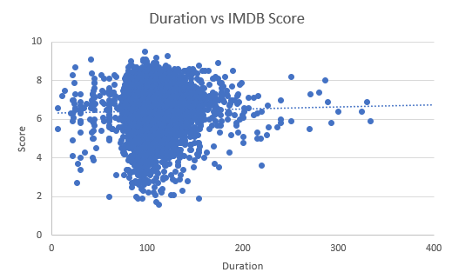
Movie Duration Analysis
The average duration of movies in the dataset is around 107 minutes.
With help of Trendline, we can identify that Movies duration between 250-300 have the IMDB score above 6.

Slide 7
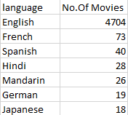
Language Analysis
The most common language used in movies is English.
Movies other than English tend to have slightly lower IMDB scores on average.

Slide 8
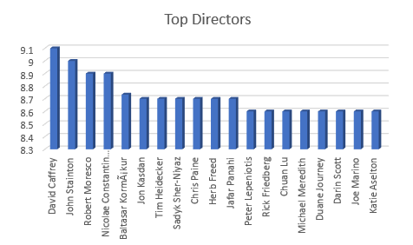
Director Analysis
Directors with high average IMDB score were identified. These Directors significantly contribute to the success of movies.
The percentile of the average IMDB ratings is 7.33 and the top performing directors were in total 503.

Slide 9
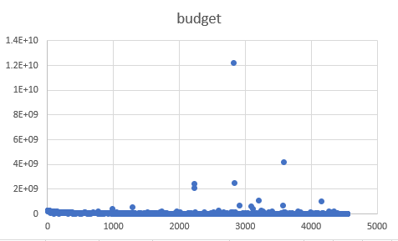
Budget Analysis
Movies with the highest profit margins were identified, showing that budget is efficiently managed.
The maximum profit was $563279547. A positive correlation between movie budget and gross was found i.e. 0.11146.

Slide 10



RESULTS
The project successfully provided actionable insights into factors influencing the success of movies on IMDB.
This project enhanced proficiency in Excel for data cleaning, analysis, and visualization. Improved my ability to draw meaningful conclusions from data.
Calle Cualquiera 123, Cualquier Lugar
Contact: manumoolimani7@gmail.com

